Slide 1
Chapter 9

Slide 2
Objectives

Slide 3
Objectives (cont.)

Slide 4
A Printable interface that defines an abstract print() method

Slide 5
A Product class that implements the Printable interface

Slide 6
A Product class that implements the Printable interface (cont.)

Slide 7
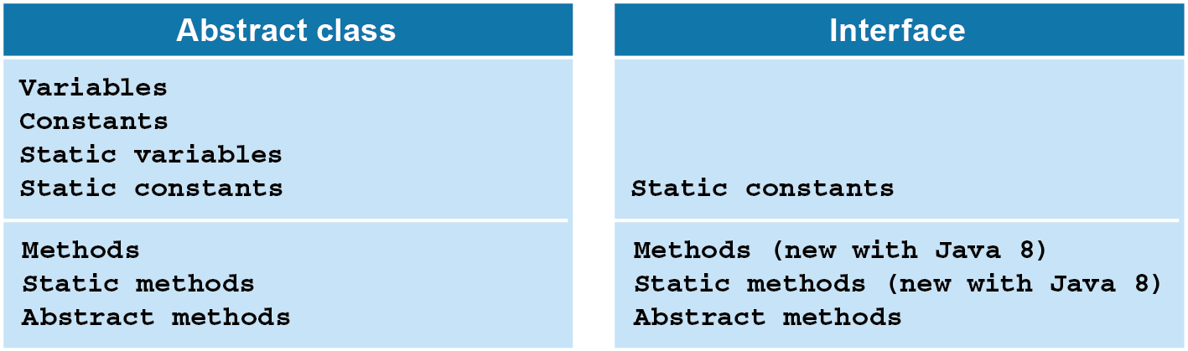
An abstract class compared to an interface

Slide 8
Advantages of an abstract class

Slide 9
A Printable interface

Slide 10
The syntax for declaring an interface

Slide 11
An interface that defines three static constants

Slide 12
The syntax for implementing an interface

Slide 13
A class that implements two interfaces (cont.)

Slide 14
The syntax for inheriting a class and implementing an interface

Slide 15
A Book class that inherits Product and implements Printable (cont.)

Slide 16
A method that accepts a Printable object

Slide 17
Code that passes a Product object to the method

Slide 18
Code that passes an Employee object

Slide 19
A ProductReader interface

Slide 20
The syntax for declaring an interface that inherits other interfaces

Slide 21
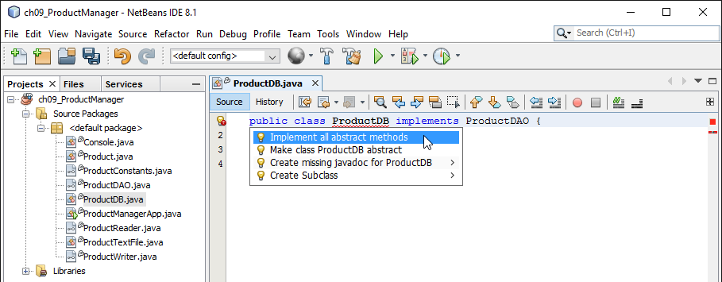
A class that implements the ProductDAO interface

Slide 22
The code that’s generated by NetBeans

Slide 23
The code that’s generated by NetBeans (cont.)

Slide 24
The syntax for declaring a default method (Java 8 and later)

Slide 25
A class that uses the default method

Slide 26
The syntax for declaring a static method (Java 8 and later)

Slide 27
The console for the Product Viewer application

Slide 28
The ProductReader interface

Slide 29
The ProductDB class

Slide 30
The ProductDB class (cont.)

Slide 31
The ProductApp class

Slide 32
The ProductApp class (cont.)

Slide 33
The ProductApp class (cont.)

Slide 34
A Product class that implements the Cloneable interface

Slide 35
Code that uses the clone() method of the Product class

Slide 36
The result of cloning a Product object

Slide 37
A LineItem class that implements the Cloneable interface

Slide 38
Code that uses the clone() method of the LineItem class

Slide 39
The result of cloning a LineItem object

